Slide 1

2023-24 Odd Semester TRAINING ON DATA STRUCTURES List ADT

Slide 2
Topics to be covered
List ADT
Operations on List
Methods of implementing List
Array Implementation of List ADT
Linked List Implementation of List ADT

Slide 3
The List ADT
A list is an ordered sequence of data items.
Data items are also called as elements.
Size of an empty list is 0
Consider A₁, A₂, A₃, …,A_{N} as a list of size N
A_{i+1} succeeds A_{i}
A_{i-1} preceeds A_{i}
Position of A_{i} is i
First element is A₁ called “head”
Last element is A_{N} called “tail”

Slide 4
Operations on Lists
MakeEmpty
PrintList
Find
FindKth
Insert
Delete
Next
Previous

Slide 5
List – An Example
The elements of a list are 34, 12, 52, 16, 12
Find (52) -> 3
Insert (20, 4) -> 34, 12, 52, 20, 16, 12
Delete (52) -> 34, 12, 20, 16, 12
FindKth (3) -> 20

Slide 6
Methods of implementing List
Array-based Implementation
Linked-list based Implementation

Slide 7
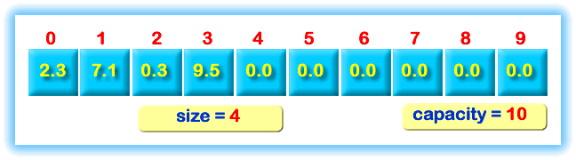
Array-based Implementation of List

Slide 8
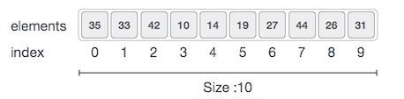
Array based Implementation
Advantages
Fast
Random access of elements
More memory efficient
Very little memory is required other than that needed to store the contents

Slide 9
Basic operations in an array
Traverse − print all the array elements one by one.
Insertion − Adds an element at the given index.
Deletion − Deletes an element at the given index.
Search − Searches an element using the given index or by the value.
Update − Updates an element at the given index.

Slide 10
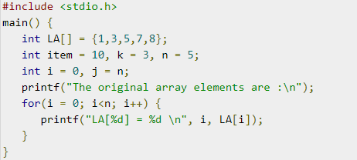
Traversing an element in an array

Slide 11
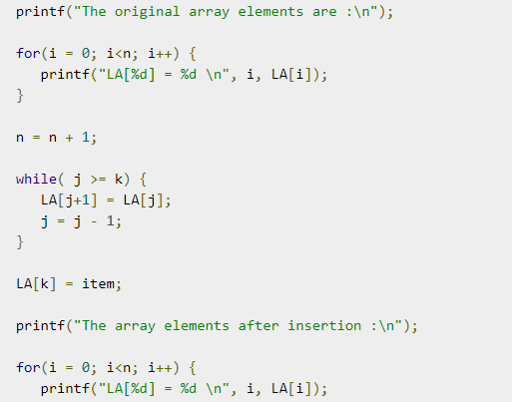
Inserting an element in the array
Assume
i=0,j=n
k as the
Position
item as the
Inserting
element

Slide 12
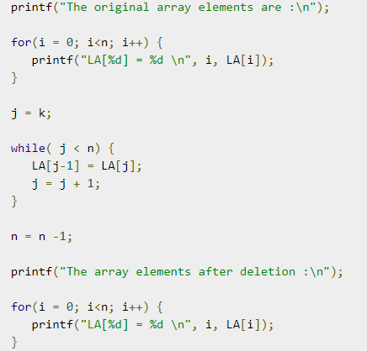
Deleting an element from an array

Slide 13
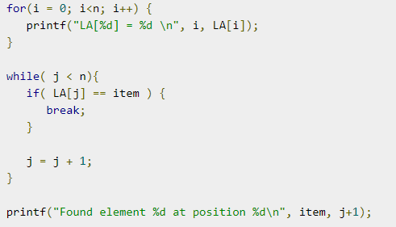
Searching an element in an array
Searching can be done based on the value or index of array

Slide 14
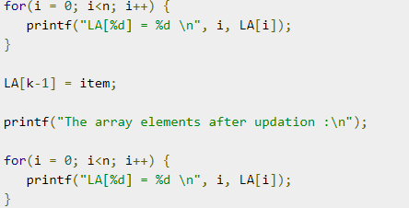
Updating an element in an array
It refers to updating an existing element from the array at a given index.

Slide 15
Disadvantages of array-based implementation
Insertion and deletion of elements take more time.
Size must be known when the array is created and is fixed
To overcome these disadvantages, linked-list based implementation is used.

Slide 16
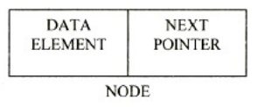
Linked list
Linked list consists of a series of nodes.
Each node has the element and a pointer to its successor node.
The pointer of last node is pointed to NULL.
Insertion and deletion are easily performed.

Slide 17
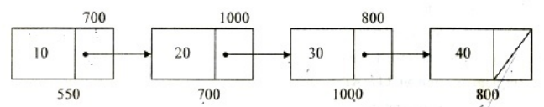

Types of linked list
Singly linked list
Each node contains only one link field pointing to the next node in the list
Doubly linked list
Each node contains two links namely forward link and backward link.

Slide 18
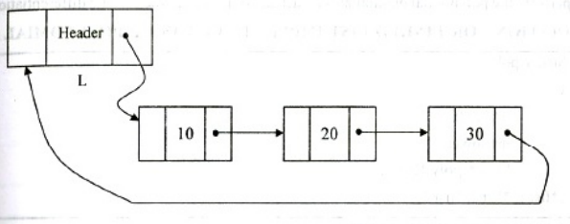
Types of linked list
Circular linked list
Pointer of the last node points to the first node
Can be implemented in two ways
1. Singly linked circular list

Slide 19
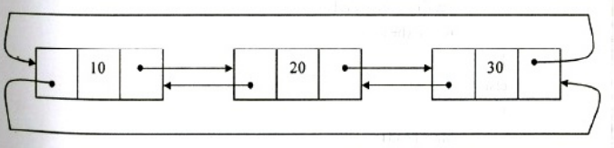
Types of linked list
Circular linked list
2. Doubly linked circular list
Forward link of the last node points to the first node
Backward link of the first node points to the last

Slide 20
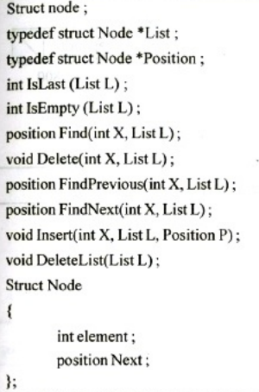
Declarations in Singly linked list

Slide 21
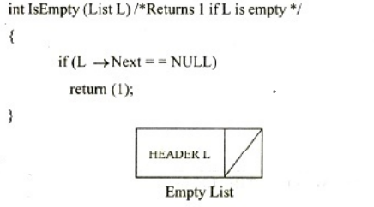
Routine to check for an empty list

Slide 22
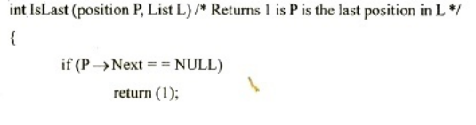

Routine to check whether the current position is the last in the list

Slide 23
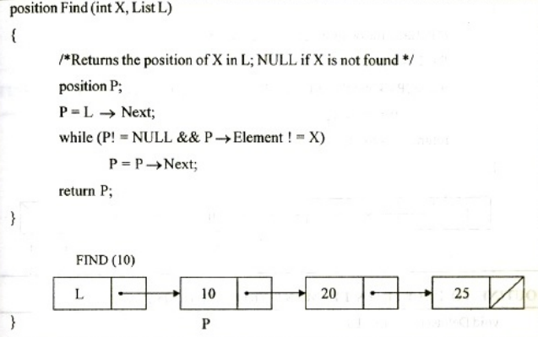
Routine to find an element in the list

Slide 24
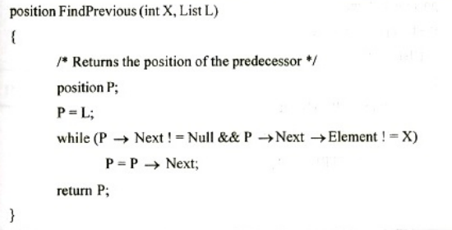

Routine to find the previous element

Slide 25
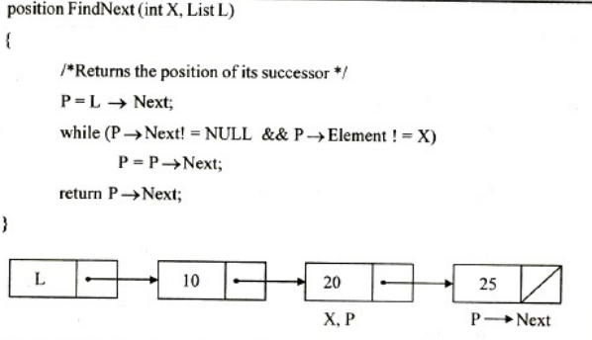
Routine to find the next element in the list

Slide 26
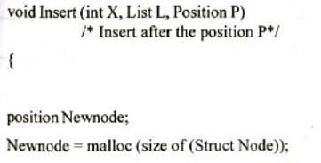
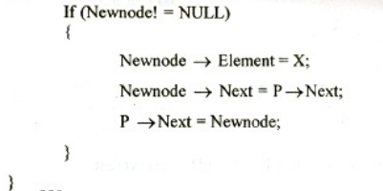
Inserting an element in the SLL

Slide 27
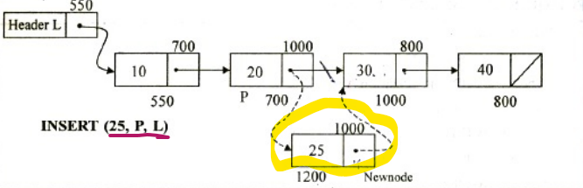
Inserting an element in the linked list

Slide 28
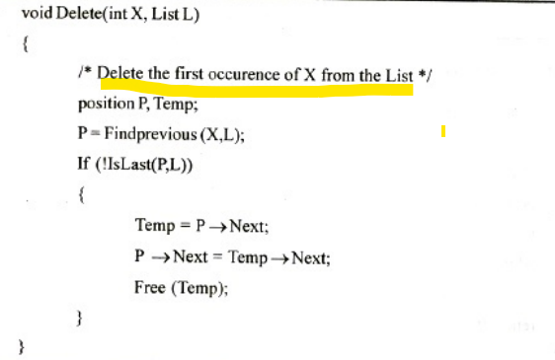
Deleting an element from the linked list

Slide 29
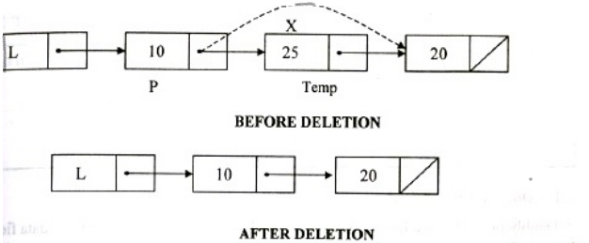
Deleting an element from the linked list

Slide 30
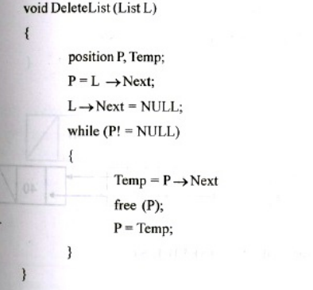
Routine for deleting the list

Slide 31
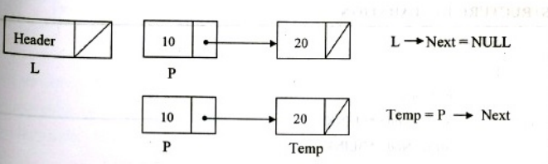
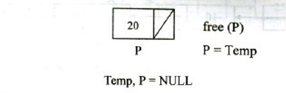
Example for deleting the list

